Slide 1
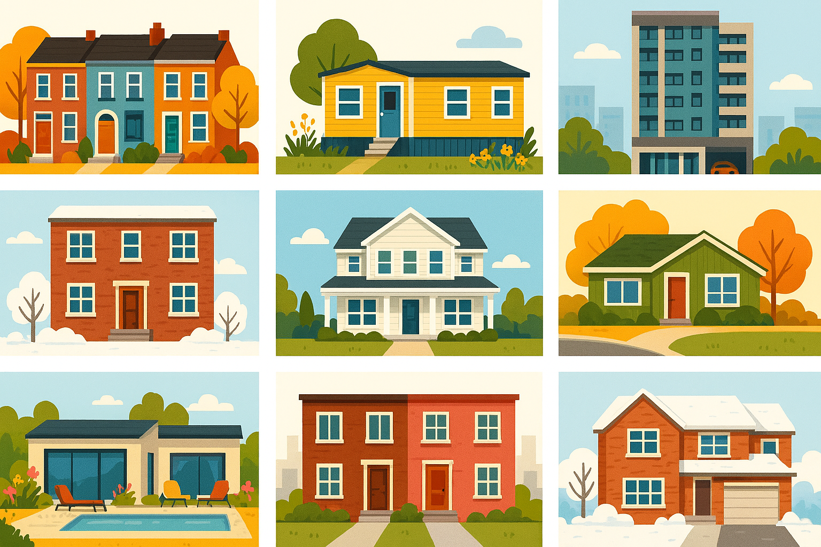
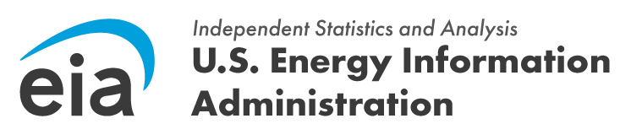
2024 Residential Energy Consumption Survey
Housing Characteristics Highlights
#RECS | www.eia.gov/recs

Slide 2
2024 Residential Energy Consumption Survey
Housing Characteristics Highlights
Last Updated: September 17, 2026
U.S. Energy Information Administration
Office of Integrated Analysis and Statistics
U.S. Department of Energy
Washington, DC 20585
This publication is available at
https://www.eia.gov/recs
  This report was prepared by the U.S. Energy Information Administration (EIA), the statistical and analytical agency within the U.S. Department of Energy. By law, EIA's data and analyses are independent of approval by any other officer or employee of the United States Government. The views in this report therefore should not be construed as representing those of the U.S. Department of Energy or other federal agencies.

Slide 3
What is the Residential Energy Consumption Survey (RECS)?
RECS is the only nationally representative source for estimates of energy-related characteristics, consumption, and expenditures for housing units in the United States.
The U.S. Energy Information Administration (EIA) collected data in two parts:
We collected housing characteristics through web and mail forms from nearly 17,000 households statistically selected to represent the 132.5 million housing units in the United States that were occupied as a primary residence in 2024.
We collected energy usage data from suppliers of electricity, natural gas, fuel oil, and propane for those same housing units.
EIA has conducted the RECS periodically since 1978.
The 2024 RECS is the 16th iteration.

Slide 4
Key takeaways from EIA’s 2024 RECS preliminary housing characteristics results
The RECS covers a wide variety of topics about household energy demand, including structural characteristics of homes, appliances, electronics, and lighting, which directly affects overall energy consumption. Here are some highlights about housing characteristics from the 2024 Household Survey of RECS:
Single-family home characteristics varied by region, with basements more common in the Northeast and Midwest, attics more common in the South, and attached garages more common in the West. These spaces can increase energy consumption because of lighting, heating, and cooling.
Excluding apartments, about 10% of households reported having swimming pools in 2024, 36% of which were heated. Pool pumps and heaters increase overall household energy consumption. Five states—Florida, California, Texas, New York, and Arizona—accounted for over 50% of all homes with swimming pools in 2024.
More households used refrigerators with bottom freezers in 2024 than in previous years.
Most homes had dishwashers in 2024 (74%), but some households had dishwashers and did not use them (14%).
Homes built between 2020 and 2024 were more likely to have separate cooktops than homes built before 1950.
Streaming device usage increased by 10 percentage points between 2020 and 2024 while usage of televisions, cable boxes, DVRs, and DVD players decreased.
Smart speaker ownership increased by four percentage points between 2020 and 2024, and more households used smart speakers to control lighting than other functions.
In 2024, 63% of U.S. households used LED bulbs for all or most of their indoor lighting.

Slide 5
Table of contents | Slide number
Structural and geographic characteristics | 6
Appliances | 11
Electronics | 17
Lighting | 20
References and additional information | 23

Slide 6
Structural and geographic characteristics

Slide 7

The presence of a basement, attic, or attached garage varied by region
Basements, attics, and attached garages by region (2024)
percentage of single-family homes
Because these are additional spaces that may use lighting, heating, or cooling, the presence of a basement, attic, or attached garage in a home can increase the home’s energy consumption.
Basements in single-family homes were more common in the Northeast (86%) and Midwest (78%).
More than two-thirds (69%) of single-family homes had attics, which were most common in the South (78%).
The West had the largest percentage of single-family homes with attached garages (74%).
United States
Northeast
Midwest
South
West
basement
43%
86%
78%
18%
21%
attic
69%
67%
67%
78%
56%
attached
garage
62%
52%
60%
62%
74%
Midwest
Northeast
West
Data source: U.S. Energy Information Administration, 2024 Residential Energy Consumption Survey
Note: Single-family homes do not include mobile homes or apartments.
South

Slide 8
The heated and cooled areas of homes varied by census division
Average total, heated, and cooled square footage by census division (2024)
average square feet (sf)
The portions of a home that are heated or cooled vary across census divisions. In New England, the estimated average heated square footage was 1,616 square feet (sf) and the estimated average cooled square footage was 912 sf.
In the warmer census divisions—South Atlantic, East South Central, and West South Central—the differences between the average heated and average cooled square footage were smaller.
New England
Middle Atlantic
East North Central
West North Central
South Atlantic
East South Central
West South Central
Mountain
Pacific
average total sf
average heated sf
average cooled sf
Data source: U.S. Energy Information Administration, 2024 Residential Energy Consumption Survey

Slide 9
One in ten homes had swimming pools
Swimming pools and hot tubs by region (2024)
Swimming pools
percentage of single-family and mobile homes
Heated swimming pools
percentage of swimming pools
Hot tubs
percentage of homes
United States
United States
United States
Midwest
Northeast
West
South
Data source: U.S. Energy Information Administration, 2024 Residential Energy Consumption Survey
Note: Swimming pool estimates exclude apartments. Hot tub estimates include all housing types.
Not including homes in apartments, about 10% of households reported having swimming pools in 2024.
Of those homes with swimming pools, 36% nationwide had heated ones, with the share ranging from 30% in the Midwest to 50% in the West.
Hot tubs were reported by 8% of households. The percentage of homes with hot tubs ranged from about 6% in the Northeast to 11% in the West.

Slide 10
Five states accounted for over 50% of homes with swimming pools
Homes with swimming pools by state (2024)
percentage of homes with swimming pools
Florida, California, Texas, New York, and Arizona accounted for 54% of all homes with swimming pools in 2024.
Florida accounted for 19% of all homes with swimming pools. Within Florida, 28% of homes had a swimming pool.
Although New York is in a cooler climate, it accounted for 6% of homes with swimming pools in the United States. Within New York state, 15% of homes had a swimming pool.
all other states
Florida
1.8 million
19%
9.6 million
homes with swimming pools in the United States
46%
14%
California
1.3 million
6%
10%
6%
6%
Texas
0.9 million
Arizona
0.6 million
New York
0.6 million
Data source: U.S. Energy Information Administration, 2024 Residential Energy Consumption Survey
Note: Swimming pool estimates exclude apartments.

Slide 11
Appliances

Slide 12
In 2024 more households used primary refrigerators with bottom freezers than in previous years
Primary refrigerator configuration (2009–2024)
percentage of homes
Refrigerator energy efficiency varies by configuration—two-door, top-freezer refrigerators often consume less energy than other configurations.
The share of primary refrigerators with bottom freezers rose from 7% in 2009 to 27% in 2024 while the share of primary refrigerators with top freezers fell from 49% to 29%.
Between 2020 and 2024 alone, the share of primary refrigerators with bottom freezers rose from 21% to 27%.
Primary refrigerators with three or more doors or with one door were the least common over the last decade.
2009
2015
2020
2024
Data source: U.S. Energy Information Administration, 2024 Residential Energy Consumption Survey

Slide 13
Most homes had dishwashers, but not all households used them
Presence of dishwashers by housing type (2024)
percentage of homes
About three-quarters (74%) of U.S. homes had a dishwasher.
Not every household used their dishwasher—about 14% of U.S. homes had a dishwasher that was not used.
  The highest proportion of dishwasher non-use was among apartments in buildings with five or more units (20%).
no dishwasher
had but didn’t
use a dishwasher
had and used a dishwasher
Data source: U.S. Energy Information Administration, 2024 Residential Energy Consumption Survey

Slide 14
Newer U.S. homes were more likely to have separate cooktops than older homes
Presence of major cooking appliances in U.S. homes, by year of construction (2024)
percentage of homes with appliance
Most U.S. homes (87%) had a range (cooktop attached to an oven), 14% had a separate cooktop, and 16% had a separate oven.
Older homes were less likely to have separate cooktops than newer homes: 8% of homes built before 1950 versus 20% of homes built in 2020 or later.
ranges
separate cooktops
separate ovens
Data source: U.S. Energy Information Administration, 2024 Residential Energy Consumption Survey

Slide 15
Daily hot food preparation varied by state
Households that cooked hot food daily, by state (2024)
percentage of households within each state
In addition to questions about cooking equipment, the RECS asks how often households use their cooking appliances and how often households cook hot meals.
  Over one-half of households in all states cooked hot food daily in 2024.
States varied in the percentage of households preparing hot food daily, ranging from about 60% in states like Louisiana (59%) and Alabama (58%), to 84% in states like Wisconsin, Oregon, and Montana.
62%
DC
- 90%
- 80%
- 70%
- 60%
- 50%
Data source: U.S. Energy Information Administration, 2024 Residential Energy Consumption Survey

Slide 16
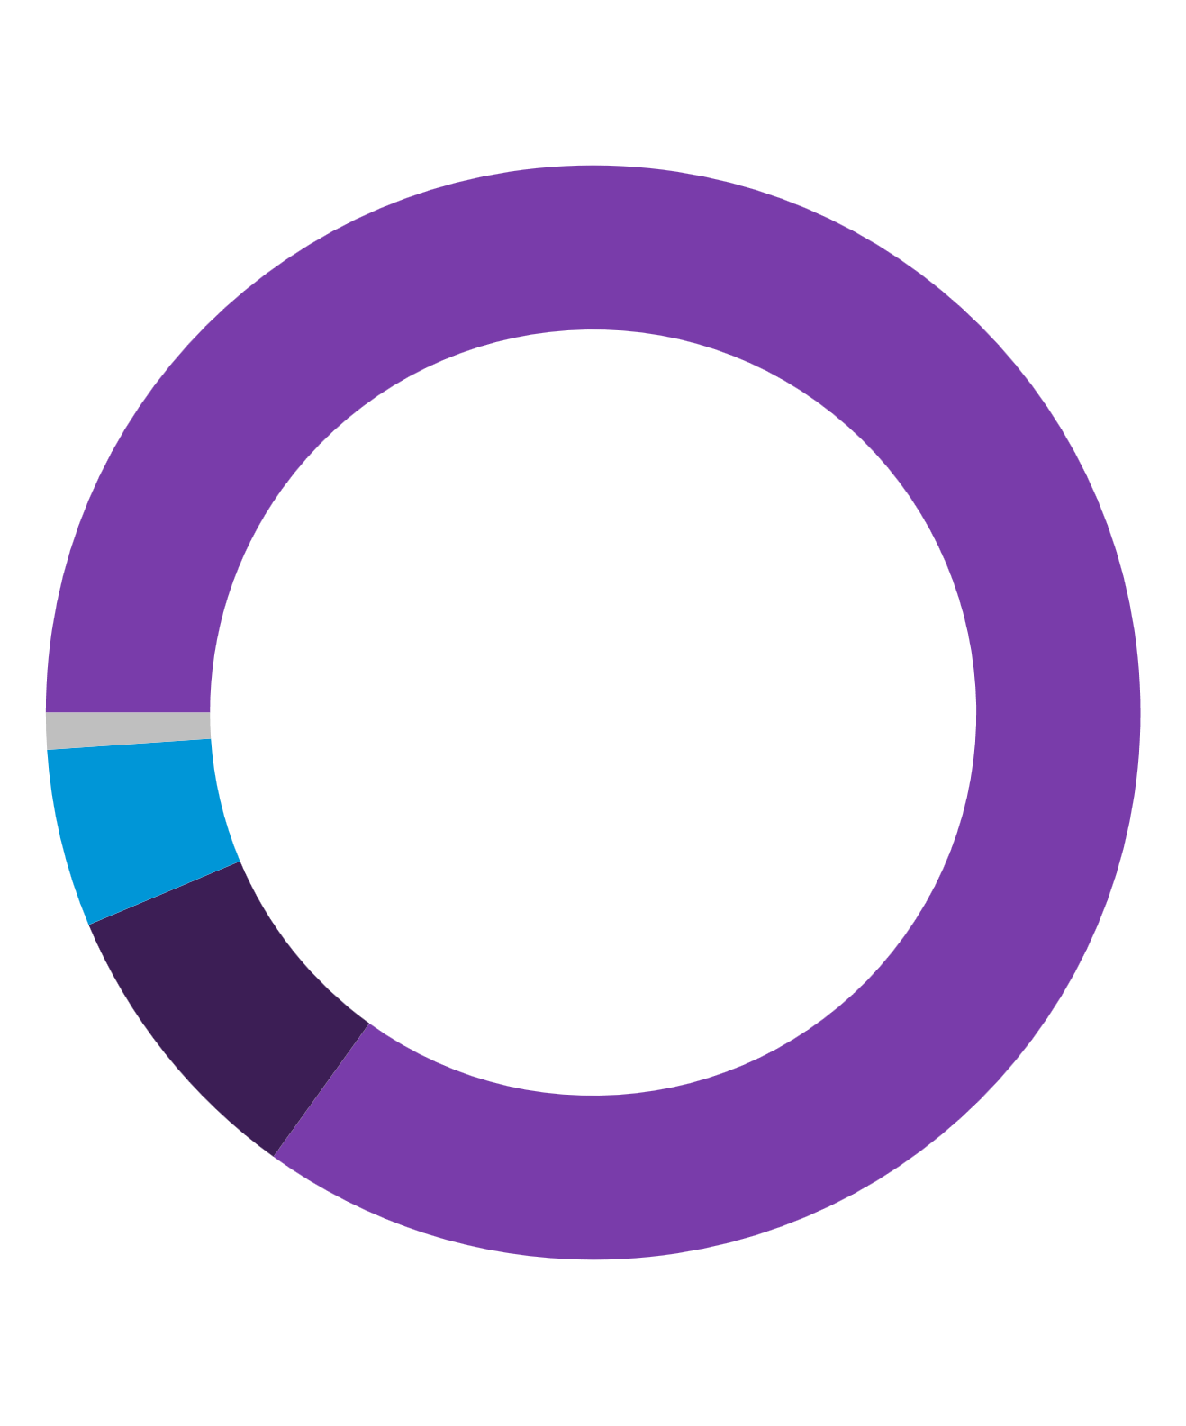
Some households used clothes washers and dryers at different frequencies per week
Clothes washer and clothes dryer usage (2024)
percentage of homes with a clothes washer and clothes dryer
Around 83% of U.S. households had both a clothes washer and a clothes dryer.
About 85% of households with clothes washers and dryers used their clothes dryer and washer the same number of times per week.
Around 9% of households with clothes washers and dryers used a clothes dryer more than a clothes washer, and 5% used a clothes washer more than a clothes dryer.
did not use a clothes washer or dryer in the home
110 million
homes with a clothes washer and a clothes dryer in the United States
85%
used their clothes washer and dryer the same number of times per week
1%
5%
used clothes washer more
9%
used clothes dryer more
Data source: U.S. Energy Information Administration, 2024 Residential Energy Consumption Survey

Slide 17
Electronics

Slide 18
Television and television peripheral usage declined
Television and television peripheral usage (2020–2024)
percentage of households
From 2020 to 2024, the percentage of households using more than one television decreased from 70% to 65%.
The percentage of households using their primary television seven hours or more per day declined from 39% to 36%.
There were also declines in usage of most television peripherals—cable boxes, DVRs, and DVD players—but the use of streaming devices increased from 56% to 66%.
2024
2020
more than one television
television watched seven hours a day or more
cable boxes without DVRs
cable boxes with DVRs
separate DVRs
DVD players
any streaming device used
Data source: U.S. Energy Information Administration, 2024 Residential Energy Consumption Survey

Slide 19
Households increased their usage of smart speakers
Smart speaker ownership and usage (2020–2024)
percentage of households
From 2020 to 2024, the percentage of households with a smart speaker increased from 32% to 36%.
Smart speakers may be used to control different functions in homes. More households controlled lighting, security systems, and temperature with smart speakers in 2024 than in 2020.
had a smart speaker
2020
2024
smart speaker used to control:
lighting
security system, cameras, or locks
television, set-top box, or streaming device
temperature
Data source: U.S. Energy Information Administration, 2024 Residential Energy Consumption Survey

Slide 20
Lighting

Slide 21
More homes used LEDs over other bulb types for indoor lighting
Homes with most or all indoor bulbs of a single type by housing type (2024)
percentage of households
About 63% of U.S. households used most or all light-emitting diode (LED) bulbs, which use less energy than most other forms of lighting.
Households in 65% of single-family homes, 57% of apartments, and 56% of mobile homes used LEDs for all or most of their indoor lighting.
In contrast, 10% of households used incandescent or halogen bulbs and 7% used compact fluorescent (CFL) bulbs for all or most of their indoor lighting.
LED
(light-emitting diode)
incandescent or halogen
CFL
(compact fluorescent)
Data source: U.S. Energy Information Administration, 2024 Residential Energy Consumption Survey

Slide 22
Almost half of all households kept at least one light bulb on for an extended period
Indoor and outdoor lighting usage (2024)
percentage of households
Almost half (47%) of all U.S. households kept at least one indoor bulb on for eight hours or more.
  These households kept an average of four bulbs on indoors for eight hours or more.
About 43% of all U.S. households kept at least one outdoor bulb on all night.
  These households kept an average of three bulbs on outdoors.
47%
yes
43%
yes
At least one indoor light bulb kept on for eight hours or more
At least one outdoor light bulb kept on all night
53%
no
57%
no
Data source: U.S. Energy Information Administration, 2024 Residential Energy Consumption Survey

Slide 23
References and additional information

Slide 24
References
All figures are sourced from Form EIA-457, 2024 Residential Energy Consumption Survey.
Please direct questions about the RECS to eiainfoconsumptionefficiency@eia.gov

Slide 25
RECS release schedule
March 2027
Final household characteristics tables¹
Consumption and expenditures tables
May 2027
Technical documentation for consumption and expenditures estimates
Final public-use microdata file
¹We will be releasing space heating, water heating, and air-conditioning estimates with the consumption and expenditures tables rather than the household characteristics tables. We are incorporating billing data into the estimates to improve their accuracy.

Slide 26
For more information
U.S. Energy Information Administration homepage | www.eia.gov
Residential Energy Consumption Survey | www.eia.gov/recs
Consumption and Efficiency | www.eia.gov/consumption
Today in Energy | www.eia.gov/todayinenergy

